Slide 1
Particles and their decays
Quarknet workshop at OU

Slide 2
Outline
Stable and unstable particles
How to observe them?
How to find their mass?
How to calculate their lifetime?

Slide 3
What is a particle?
Matter around us consists of a few types of particles (both fundamental and just subatomic particles that have some structure):
Protons
Neutrons
Electrons
Neutrinos
Photons
Create a lot of particles on accelerators in collisions of protons and antiprotons or protons and protons, or electrons and protons
Are these creatures really particles?
Why?

Slide 4
“Definition” of a particle
Has a “certain” mass
Has some non-zero lifetime (can be as small as 10⁻²⁴ s, but it is measurable, so we know that it is non-zero)
Has certain quantum numbers like
Electric charge
Spin
Lepton or baryon number
Charm, or strangeness, etc

Slide 5
Stable and unstable particles
Things around us look like homogeneous objects, but if you look deeper it’s not true: they are made of tiny particles
These particles are stable: left to themselves, they don’t disappear
matter → atoms → electrons + nuclei → protons + neutrons → quarks

Slide 6
Particle decays
In macroscopic world, things sooner or later break down into components: trees fall and rot, buildings fall into ruins… we call it decay
In microscopic world, some particles turn themselves into combinations of other particles – this is called particle decay
E.g. a free neutron (outside a nucleus) turns itself into a proton, an electron, and an antineutrino
It is not possible to tell when a given particle will decay
in a large group of identical particles the fraction of particles remaining after time t is exp(-t/τ)
τ is called the particle lifetime

Slide 7
Particle lifetimes
They can be really large
Protons are usually considered stable, but some models predict that they eventually decay
Proton lifetime > 10³⁴ years – no reason to worry☺
They can be moderate
A free neutron has lifetime ~15 min
They can be really small
Some particles decay almost immediately after they are born – they are called resonances

Slide 8
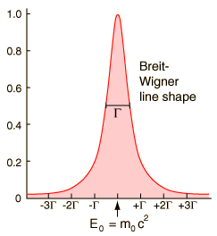
Lifetime of resonances
The uncertainty principle provides a tool for characterizing the very short-lived products produced in high energy collisions in accelerators. The uncertainty principle suggests that for particles with extremely short lifetimes, there will be a significant uncertainty in the measured energy. The measurement of the mass energy of an unstable particle a large number of times gives a distribution of energies called a Breit-Wigner distribution.
If the width of this distribution at half-maximum is labeled Γ , then the uncertainty in energy ΔE could be reasonably expressed as where τ is lifetime

Slide 9
Particle decays and forces
Like all processes involving particles, particle decays are driven by fundamental interactions
The particle lifetimes are determined by the type of underlying interaction
Particles which decay due to strong force have extremely small lifetimes: τ(Δ⁺→pπ⁰)=6×10^{‒24} s
Particles which decay due to weak force can have large lifetimes (neutron)

Slide 10
Laws of particle decays
Particle decays may look strange...
Imagine a Ford car which, instead of rusting and falling apart, turns itself in a couple of new motorbikes…
… but they are governed by strict laws
Conservation of energy / momentum: total energy / momentum of all products is equal to original particle energy / momentum (don’t forget to account for masses: E=mc²)
Conservation of electric charge
Other rules, e.g. conservation of baryon number

Slide 11
Observation of particles
We can’t see particles – they are too small, how we detect them?
When particles go through matter, they release energy which can be registered by various detectors
The presence of a particle is confirmed by a series of points of released energy – the particle trajectory
The question is, is the lifetime of the particle long enough to create a trajectory?
Particles can’t travel faster than the speed of light, therefore their typical travel length is L=cτ
If the particle has very large energy, then according to relativistic mechanics, L=cτ/√1-v²/c²

Slide 12
Resonances
In many cases, the particle lifetimes are too small to produce a detectable trajectory
For strongly decaying particles, cτ ~ the size of the nucleus, which is natural because it is the strong force which binds particles in nuclei together
In this case, all we can observe are the particle decay products. How do we prove that there was something that gave rise to these products?
Each particle is characterized by a unique combination of properties (mass, charge, spin…)
Due to conservation laws, these properties are propagated to the properties of the decay products

Slide 13
Invariant mass
In particle physics, the invariant mass is a mathematical combination of the system energy E and momentum p which is equal to the mass of the system in the rest frame. It is the same in all frames of reference:
Example: a system of two particles:

Slide 14
Invariant mass as an evidence
If two particles in fact are decay products of a “mother” particle, their invariant mass will be equal to the mass of original particle
This is a very strong evidence: the only relation between decay products if their common origin
When looking for invariant mass, remember that:
In quantum mechanics you can’t judge from a single case – you need statistics (many events)
According to quantum mechanics, the invariant mass has uncertainty (Δm~1/τ)
Energies and momenta of decay products can’t be measured with infinite accuracy (smearing)
There are particles which are not originating from the resonance, they form a pedestal (background)

Slide 15
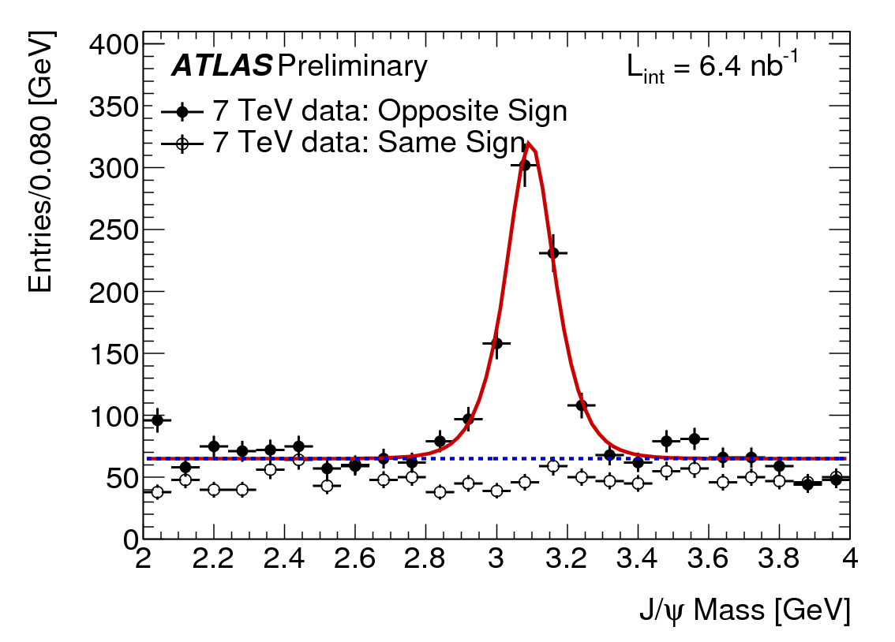
Example: J/ψ particle at ATLAS
If two muons have same charge (+e or –e) they can’t originate from J/ψ
no preferred invariant mass
Two opposite sign muons exhibit an invariant mass peak near 3.1GeV
J/ψ→μ⁺μ‒

Slide 16
How does a particle decay?
The Standard Model explains why some particles decay into other particles
In nuclear decay, a nucleus can split into smaller nuclei
When a fundamental particle decays, it has no constituents (by definition) so it must change into totally new particles

Slide 17
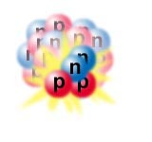
The Unstable Nucleus
We have seen that the strong force holds the nucleus together despite the electromagnetic repulsion of the protons
However, not all nuclei live forever
Some decay

Slide 18
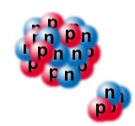
Nuclear Decay
The nucleus can split into smaller nuclei
This is as if the nucleus “boiled off” some of its pieces
This happens in a nuclear reactor

Slide 19
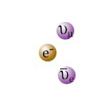
Muon Decay
Muon decay is an example of particle decay
Here the end products are not pieces of the starting particle but rather are totally new particles

Slide 20
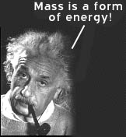
Missing Mass
In most decays, the particles or nuclei that remain have a total mass that is less than the mass of the original particle or nucleus
The missing mass gives kinetic energy to the decay products

Slide 21
How to find a Higgs boson?
The Higgs boson is unstable, it decays before it can be detected by any of the ATLAS subsystems
it can only be observed through its decay products
To explain the details, let’s talk about another particle – Z boson
Z is routinely used at the Fermilab experiments for detector calibration, and will also be used so at the LHC
like Higgs, Z immediately decays after it’s born
let’s consider one of its decay modes: Z→e⁺e⁻

Slide 22
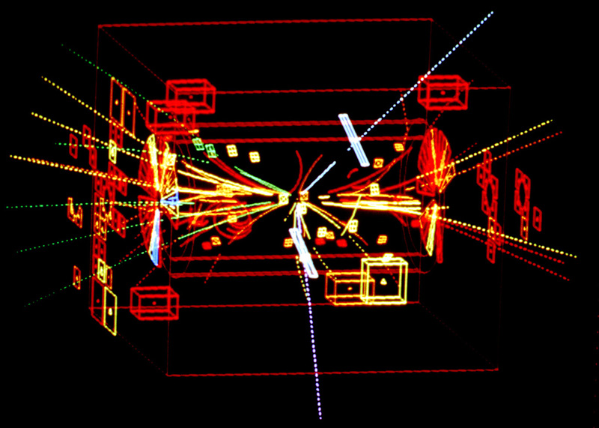
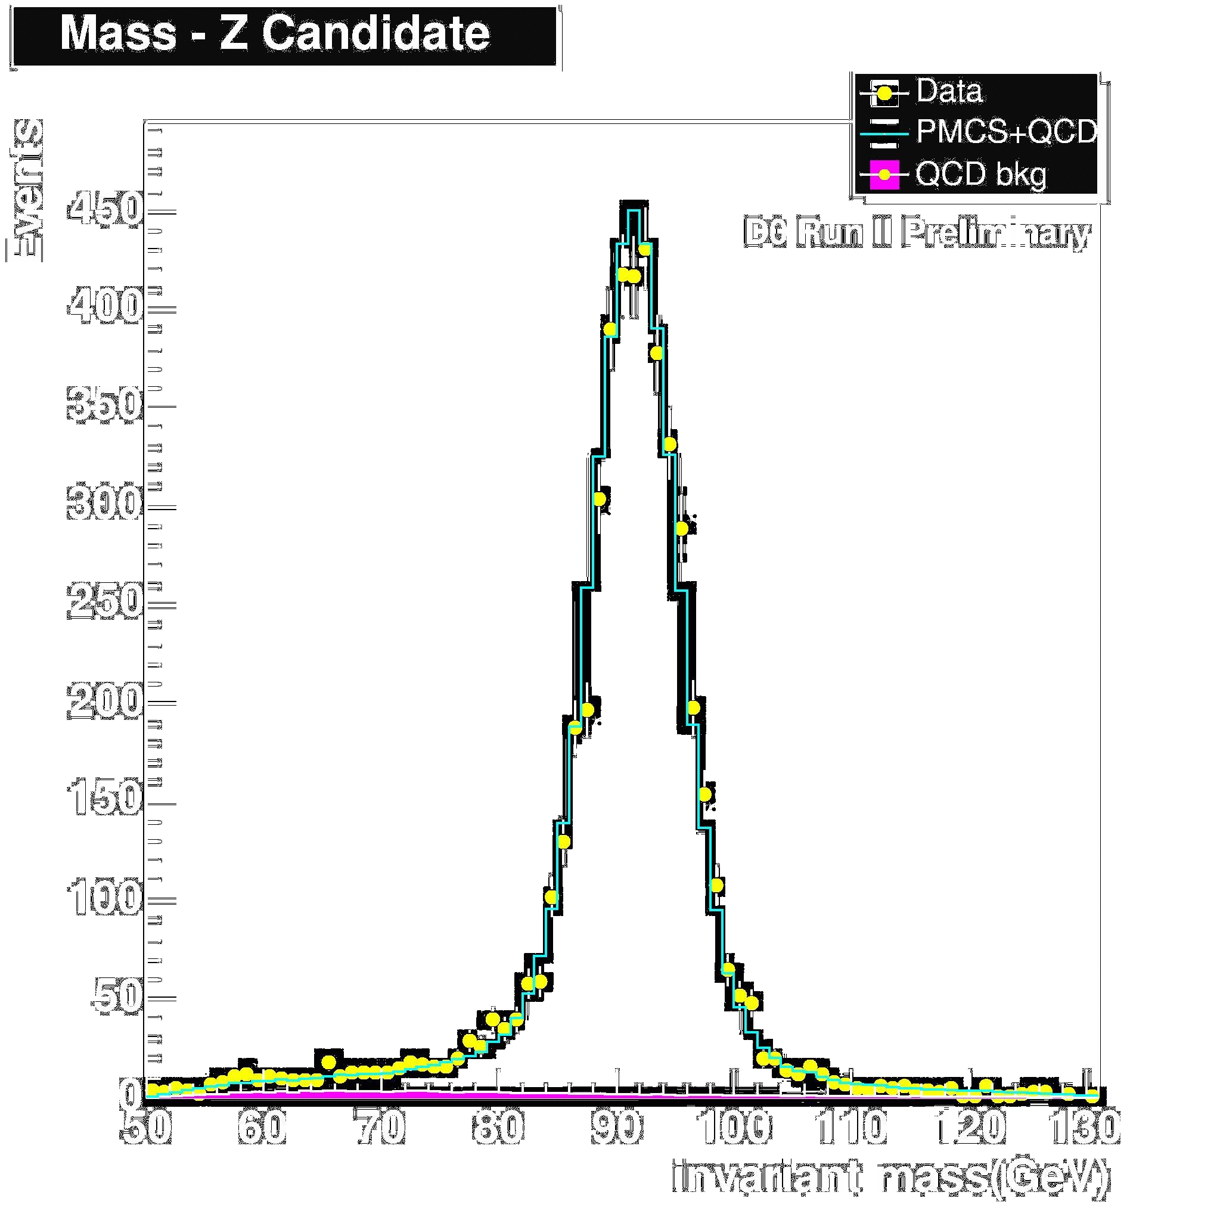
How to see a Z?
We select events which have two high transverse momentum electrons of opposite charge
We calculate invariant mass of these electrons:
One event is not enough !
Need many events to see a peak

Slide 23
What about Higgs?
Like Z, the Higgs boson is unstable and quickly decays into other particles
Light Higgs preferably decays to a pair of b-quarks
now that’s another trouble – quarks do not show up as free particles, they undergo hadronization
what you see in the detector is a bunch of collimated particles moving in a narrow cone – a jet
we need to detect events with jets, separate jets produced by b-quarks, calculate their invariant mass, and get our hands on Higgs!
Certainly, hard to observe in this decay mode…

Slide 24
Other decay channels of Higgs boson
Higgs boson can decay to a pair of photons!
Good thing about this decay: easy to observe
Use electromagnetic calorimeter + tracking (require NO track, since photons do NOT leave tracks in the tracking detectors)
Bad thing – very rare decay… Need a LOT of data to observe it

Slide 25
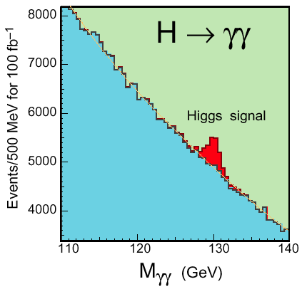
Higgs Decay to Photons
Rare decay in SM
t
γ
H
t
γ
LHC detectors have been optimized to find this peak!

Slide 26
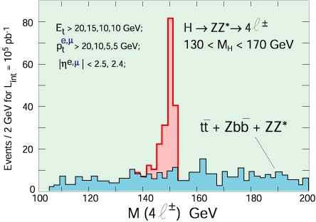
Higgs Decay to ZZ
Requires precise measurement of muon curvature

Slide 27
Conclusions
We can measure the mass of a decayed particle using measured momenta and energies of its decay products
We can measure the lifetime by looking at the rate at which this type of particle decays or by measuring the mass distribution accurately
Lets try to find a Higgs boson! (next activity)

